Slide 1
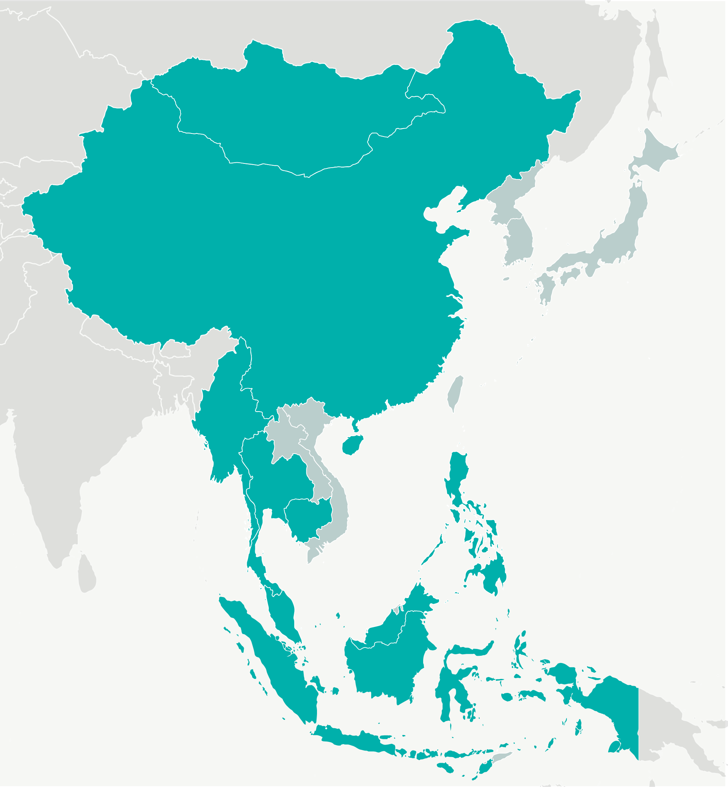

East and Southeast Asia’s Muslims
Notes:
Introduction to the Muslim peoples of these regions

Slide 2

292 million followers of Islam
Notes:
Asia is home of 65 percent of the world's Muslims, and Indonesia, in Southeast Asia, is the world's most populous Muslim country.

Slide 3
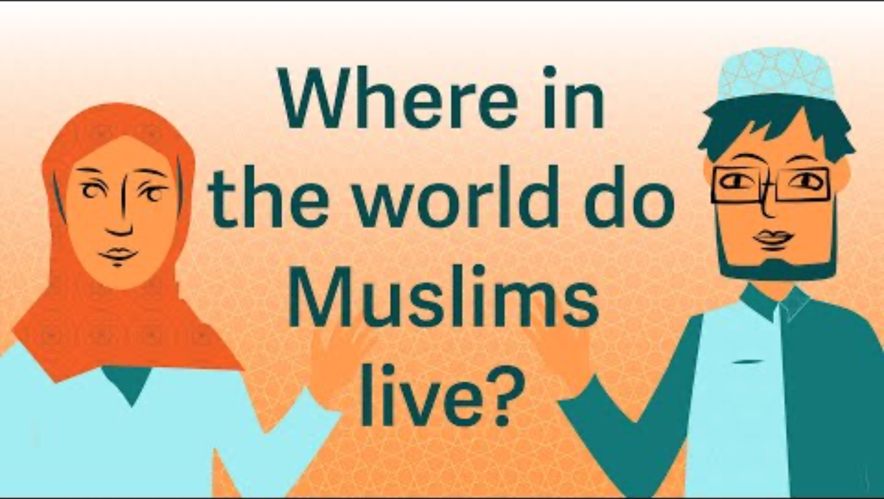
Notes:
This short video tells of how Islam reached East and Southeast Asia from its origins in the Middle East.
*Source: YouTube linked video (https://youtu.be/8YTIxogr1E4) 1 minute

Slide 4

East and Southeast Asia’s Muslim Populations
China
28.8 million
Philippines
7.9 million
Myanmar
2.3 million
Cambodia
3.1 million
Indonesia
229 million
Thailand
3 million
Malaysia
16.3 million
Others
1.2 million
Notes:
It is often said that more Muslims live in Indonesia than in the Middle East
The yellow circles denote Muslim majority nations
*Source: World Population by Country 2023 (Live).” World Population by Country 2023 (Live), worldpopulationreview.com/. Accessed 30 Aug. 2023

Slide 5



381 People Groups
Notes:
There are a huge number of Muslim people groups in these regions – they are defined by their different cultures and languages or dialects.
For example, the national motto of Indonesia is “Unity in diversity”
This is true of Islam practiced in the region
There is Unity in their Islamic practices, daily prayers facing Mecca, greeting each other with the traditional Arabic blessing “Alsalem Alaikum” which means “Peace be with you”
There is diversity in the way local customs inform the practice of Islam, e.g. the visiting of dukuns, visitation of tombs or maybe using drums for the call to prayer

Slide 6
East and Southeast Asia’s Christian Populations
China
130 million
Philippines
106 million
Myanmar
4.6milliom
Cambodia
577,000
Indonesia
32 million
Thailand
1.4 million
Malaysia
3.4 million
Singapore
779,000
Brunei
39,000
Notes:
East and Southeast Asia are two of the most religiously diverse regions in the world. In 2020, overall, they are home to significant populations of Christians (12%) and Muslims (12%). E.g., there are nearly 33 million in Indonesia and nearly 133 million in China
Regionally, Christianity experienced the fastest growth between 1970 and 2020 (3.1% per year).
Yellow circles represent countries where there are more Muslims than Christians,
In the region the different religious communities’ live side by side, there are also many Christian ex-pat workers attracted to the booming Southeast Asia economy.
*Source for population numbers on the slide: Joshua Project (2024), Lists: all countries, https://joshuaproject.net/global/countries. Accessed 24 Jun. 2024
*Source for comment Zurlo, G. A. (2020). A Demographic Profile of Christianity in East and Southeast Asia. In K. R. Ross, F. D. Alvarez, & T. M. Johnson (Eds.), Christianity in East and Southeast Asia (Vol. 1, pp. 3–14). Edinburgh University Press. http://www.jstor.org/stable/10.3366/j.ctv2f4vqsr.6

Slide 7

Notes:
This short video shares four ways that Christians can be a blessing to the Muslim people, produced by OMF International who have a long experience of living amongst and blessing Muslim peoples in East and Southeast Asia.
*Source: YouTube linked video (https://youtu.be/8YTIxogr1E4) 1 minute

Slide 8
Percentage of Population Reachable by Social Media
China
74.2%
Philippines
73.4%
Myanmar
33.8%
Cambodia
66.4%
Indonesia
49.9%
Thailand
68.4%
Malaysia
83.1%
Singapore
85%
Brunei
63.3%
Notes:
Percentage of population on social media – yellow circles represent Muslim majority nations
Social media is a key part of life in East and Southeast Asia, most users access this media via their mobile / cell phones.
It is a good way to get information to people in the region.
*Source: https://wearesocial.com/uk/blog/2024/01/digital-2024-5-billion-social-media-users/ Accessed 25 Jun. 2024

Slide 9

Opportunities for prayer
The Muslim Peoples of East and Southeast Asia
Ask for Muslims to see God’s mercy at work in followers of Jesus within their communities
Pray for Christians in the region to connect well with their Muslim neighbors so that they can be a blessing to them
Thank God that Muslims can learn more about Jesus on social media
Notes:
Prayer makes a difference. Join in praying that God would move powerfully in the lives of the Muslim peoples of East and Southeast Asia. May we see families, churches, and societies transformed by God’s love through Christ Jesus.

