Slide 1

Prayer Meeting
for the Evangelization of East Asia’s peoples

Slide 2
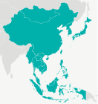
Nearly
1 : 3
people in the world live in East and Southeast Asia

Slide 3

Less than 1 in 10 know and follow Jesus

Slide 4

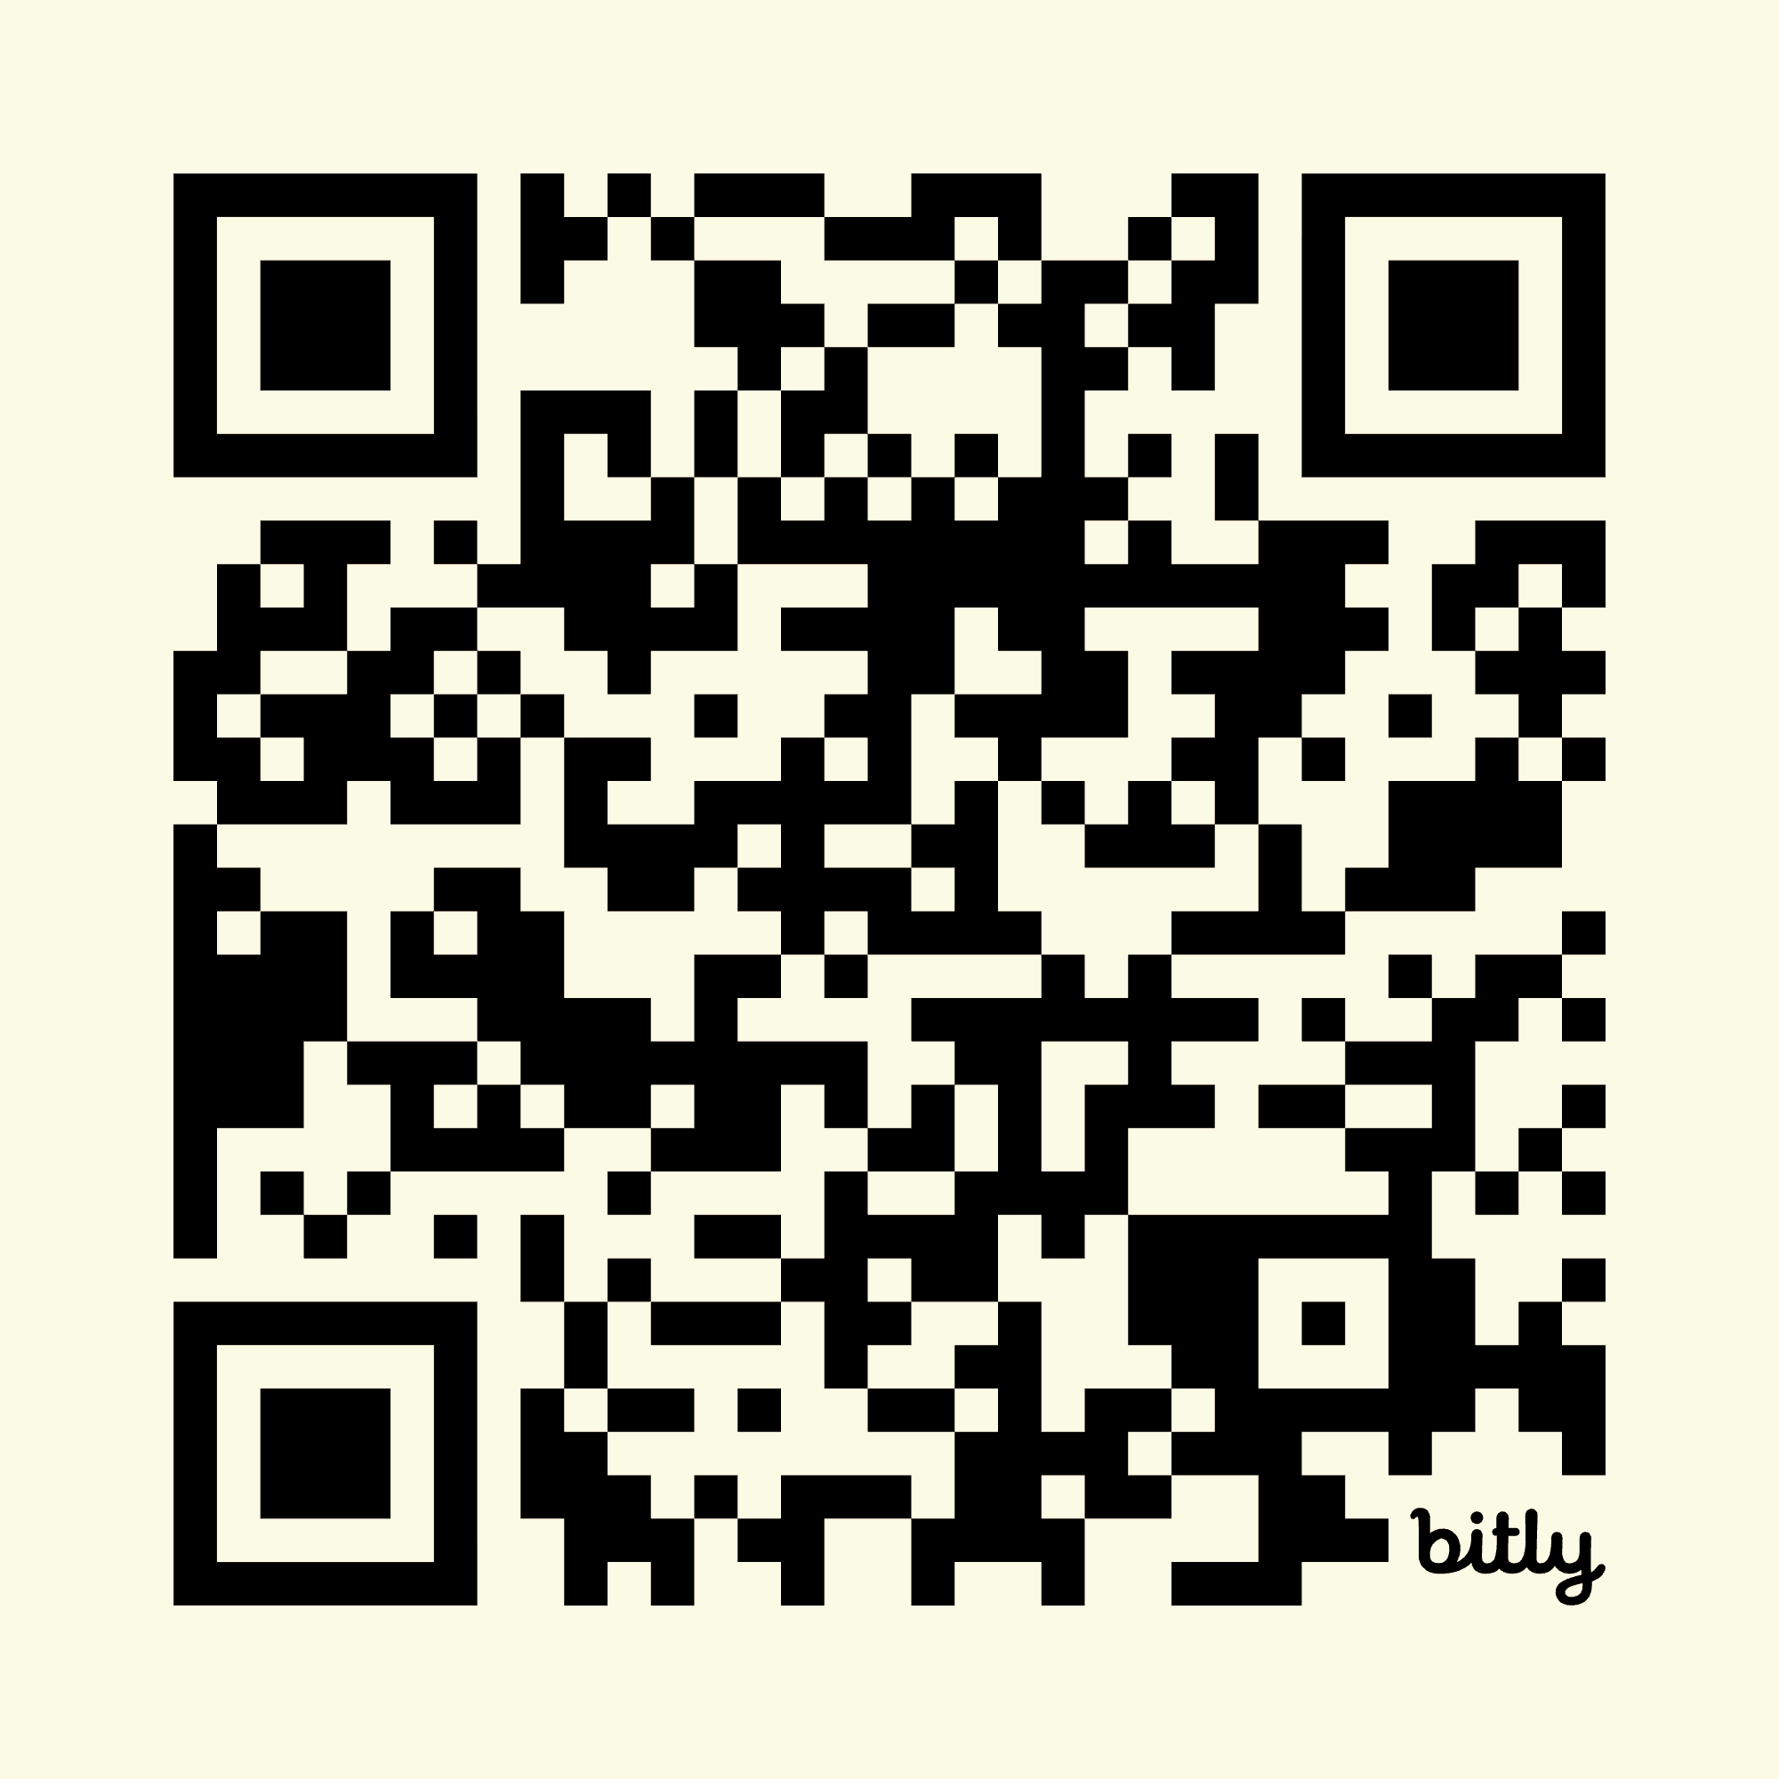
“How, then, can they call on the one they have not believed in? And how can they believe in the one of whom they have not heard? And how can they hear without someone preaching to them?”
– Romans 10:14

Slide 5

Big PICTURE Prayers
For the Father to give Christians worldwide a vision for the evangelization of the peoples of East and Southeast Asia
For Holy Spirit to work amongst the peoples of East and Southeast Asia so they know and follow the Lord Jesus
For Lord to glorify himself by sustaining and expanding a gospel ministry amongst the peoples who do not yet know Jesus
For the provision of cross-cultural workers willing to live gospel lives amongst those who do not know Jesus

Slide 6

Integral mission
… through living lives modelled on Jesus
‘The word became flesh and made his dwelling among us.’
- John 1:14
Pray for God to show the unreached of Asia his heart for them using Christians whose whole life reflects Jesus
Pray the Lord will give Christians in East and Southeast Asia a fresh vision to see the unreached as he sees them
Ask God to enable the wider church to embrace whole mind, body and soul gospel ministries
Thank God for the privilege of being Christ’s ambassadors

Slide 7

Planting churches
… and building an empowered body of believers
‘… so that the body of Christ may be built up until we all reach unity in the faith and in the knowledge of the Son of God and become mature, attaining to the whole measure of the fullness of Christ’.’
- Ephesians 4:12-13
Ask the Lord to raise up new churches amongst unreached peoples
Pray for the new churches to look to God for their needs
Pray God will give church planting teams wisdom and strength to strive for the Kingdom in all circumstances
Ask God to show you how to help empower your church

Slide 8

Marketplace ministry
… using the Lord’s gifting to make Jesus known
‘In the same way, let your light shine before others, that they may see your good deeds and glorify your Father in heaven.’
- Matthew 5:16
Praise God for using ordinary people’s skills to relocate them to the places where he calls them
Ask God to equip and send people to share their faith and make disciples using their professions cross-culturally
Pray God will give the people of East and Southeast Asia soft hearts to hear the gospel from co-workers and employers
Ask God to show you how you can use your work to glorify him.15

Slide 9

Living life
… and daily showing the teachings of Jesus in our lives
‘rather, he made himself nothing by taking the very nature of a servant, being made in human likeness.’
- Philippians 2: 7
Pray for the Lord to grow Godly relational witness between cross cultural workers and those who do not know Jesus
Ask God to inspire Christian workers with creative gifting to use them for his glory in their daily lives
Pray for young Christians to see how their gifting could serve the Lord as a gospel witness
Ask God to help you encourage others to grow in faith

Slide 10

Caring for creation
… while also pointing to the Creator
‘The son is the image of the invisible God, the firstborn over all creation’
- Colossians 1: 16
Give thanks for how wonderfully God has created the world
Pray God to use creation care work to inspire unreached people to want to know more of their Creator
Pray for the Holy Spirit to prompt Christians to care for the environment and nurture all our children’s future
Pray God will show you his heart for your community by caring for his creation

Slide 11

Online ministries
… sowing the gospel using social media
‘‘Consequently, faith comes from hearing the message, and the message is heard through the word about Christ.’
- Romans 10:17
Pray God will draw many people to take steps to following Jesus as they watch evangelistic videos on social media
Ask God to guide those who choose the online topics to ones that will appeal to seekers and reach those he has prepared
Ask God to give wisdom to all Christians over online witness
Pray God to direct you to evangelistic social media you can share with friends

Slide 12
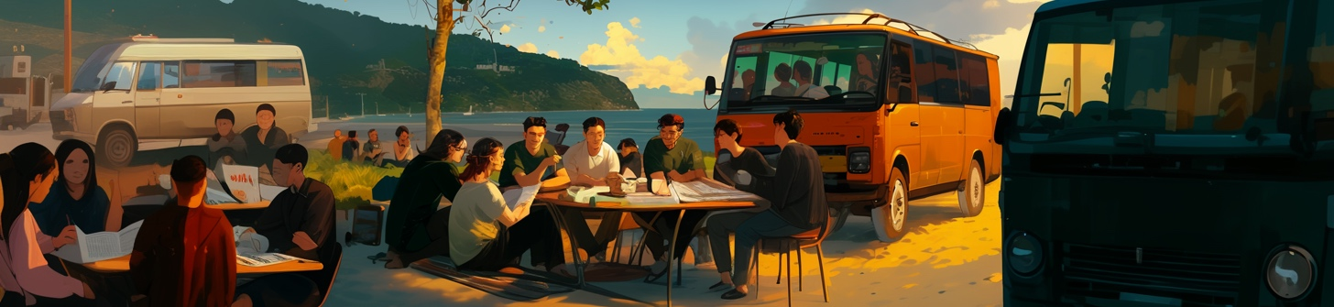
How can I carry this forward?
Download and share the prayer guide Ways to Pray for East Asia
LEARN・PRAY・GO・SEND・WELCOME・MOBILIZE
… are six ways that you can help reach God’s world
For more information contact your local OMF representative

Slide 13

Heart for Asia. Hope for Billions.
omf.org

